Slide 1

Comprehensive benchmark of supervised-learning algorithms for predicting cancer states
Stephen R. Piccolo Assistant Professor Department of Biology
@stevepiccolo

Slide 2
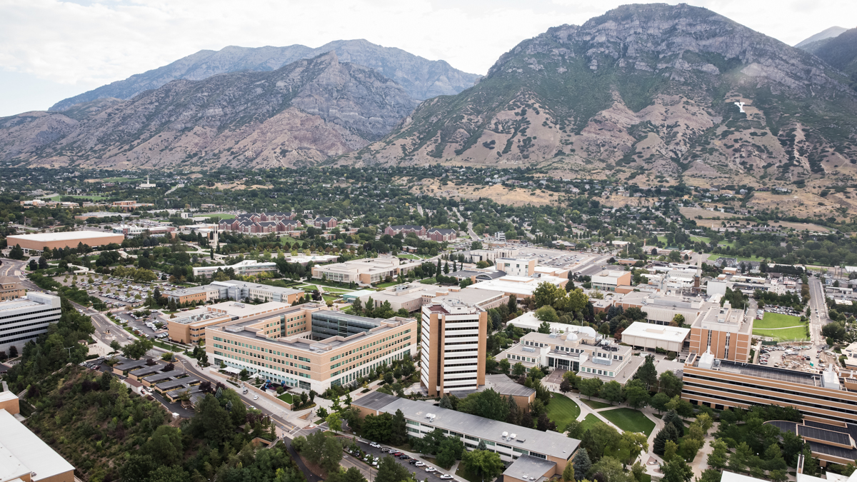

Slide 3
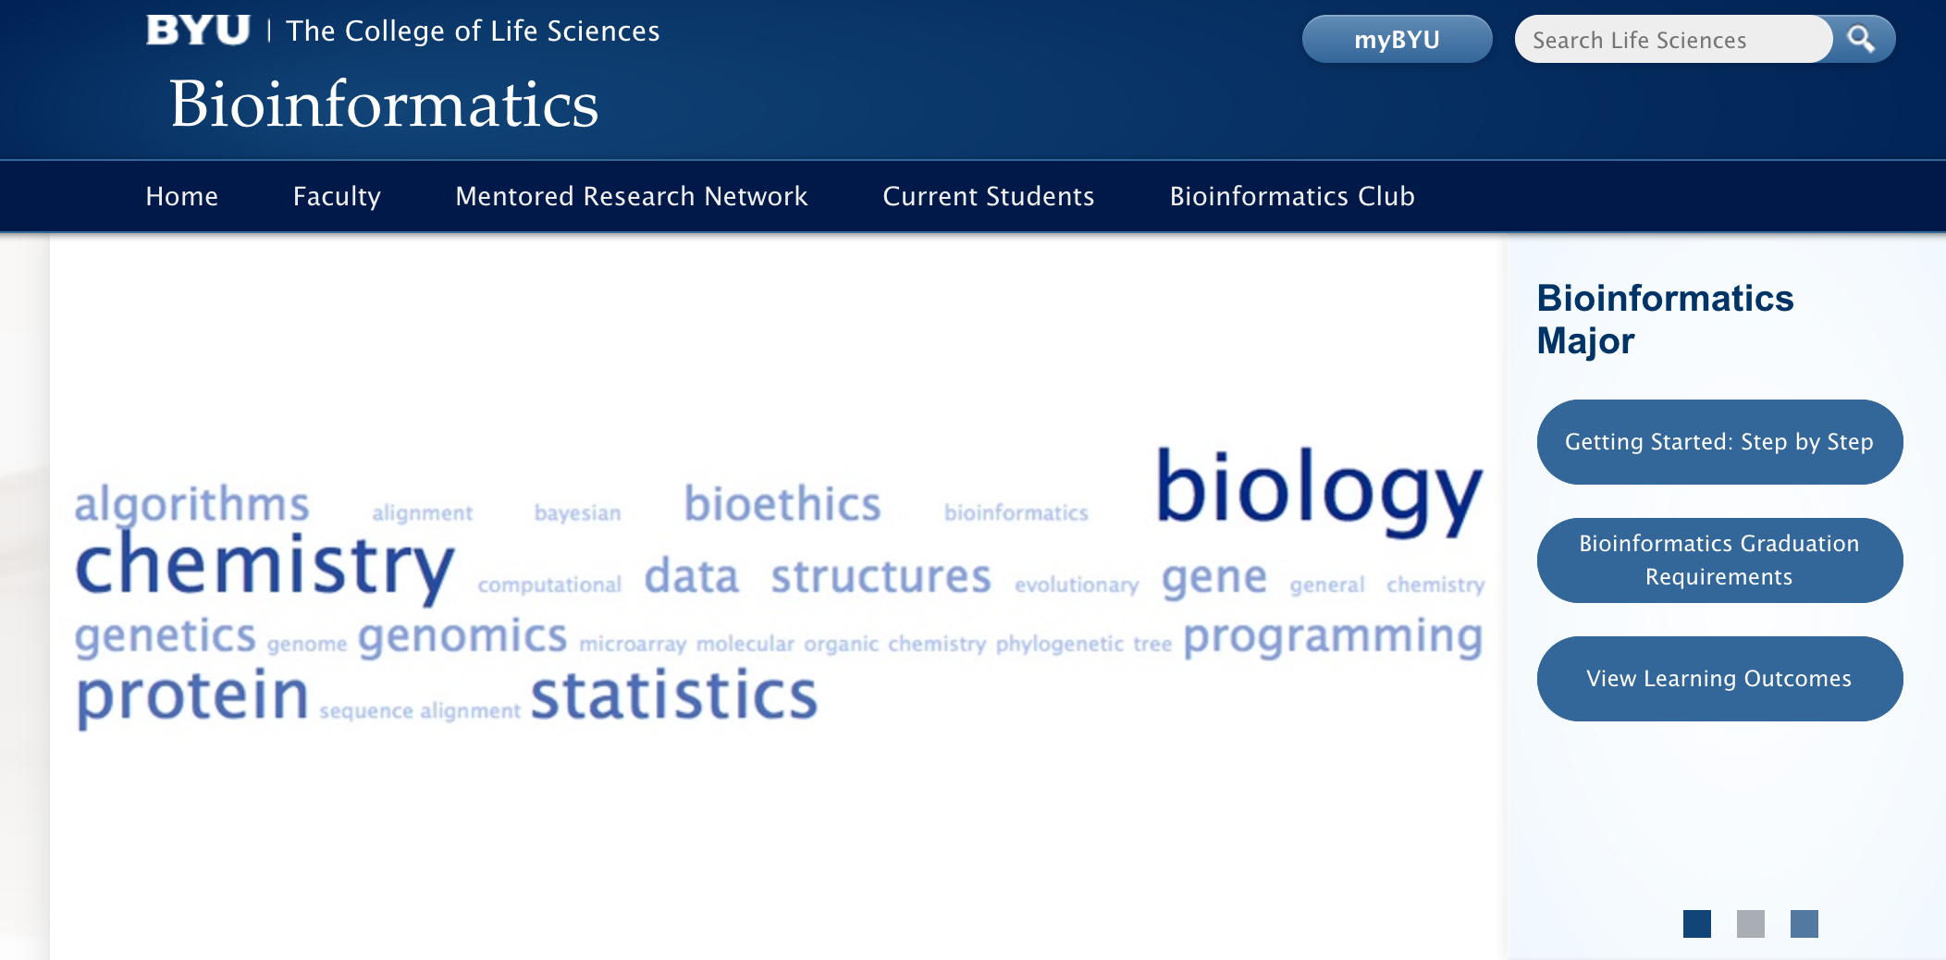
https://bioinformatics.byu.edu

Slide 4
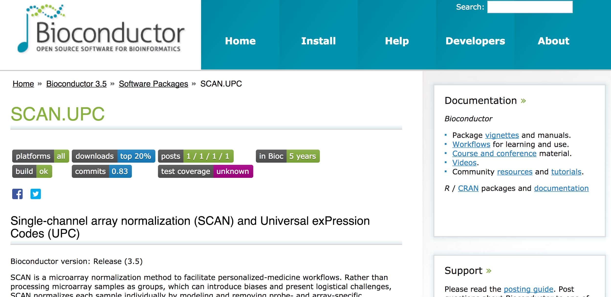

Slide 5
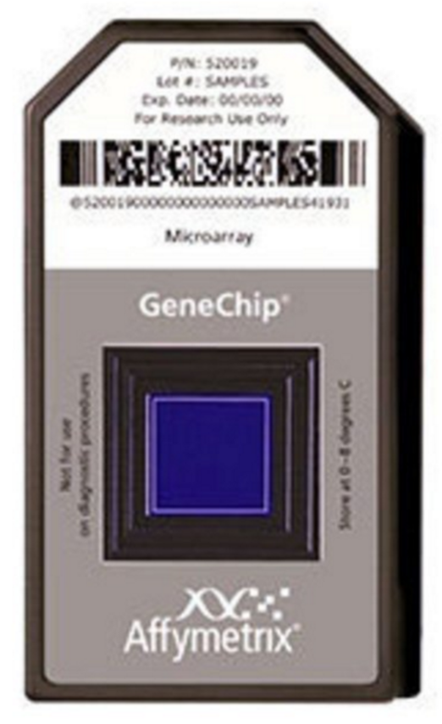
Supports all Affymetrix gene-expression arrays

Slide 6
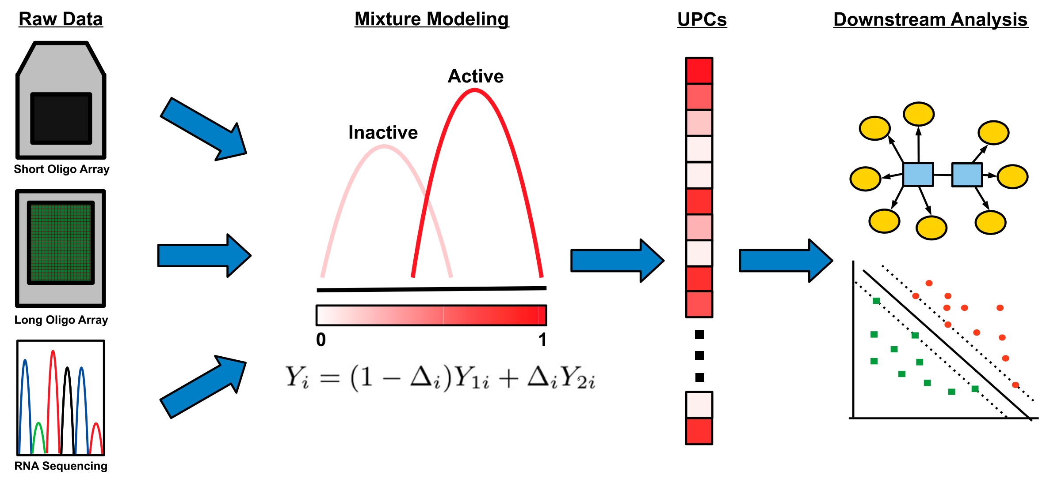
Also other platforms (UPC)

Slide 7
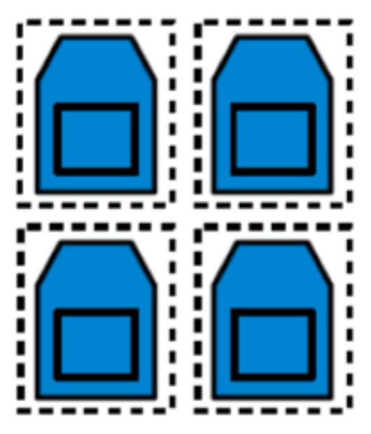
Single-sample normalization

Slide 8
Easy integration with GEO
series = SCAN("GSE22309")
sample = SCAN("GSM555237")

Slide 9
Easy integration with BrainArray
InstallBrainArrayPackage(celFilePath, "20.0.0", "hs", "ensg")
normalized = SCAN(celFilePath, probeSummaryPackage=pkgName)

Slide 10
Support for parallel processing
library(doParallel)
registerDoParallel(cores=2)
series = SCAN("GSE22309")

Slide 11
Predicting cancer states

Slide 12
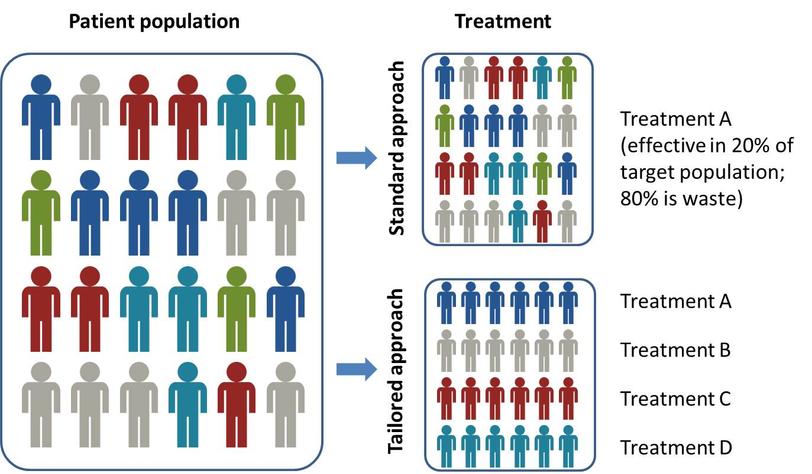
Courtesy: http://www.questdiagnostics.com/home/physicians/testing-services/by-test-name/precision-medicine-offerings.html

Slide 13
Cancer "states"
Treatment success
Diagnosis / subtype / stage
Metastasis
Prognosis

Slide 14
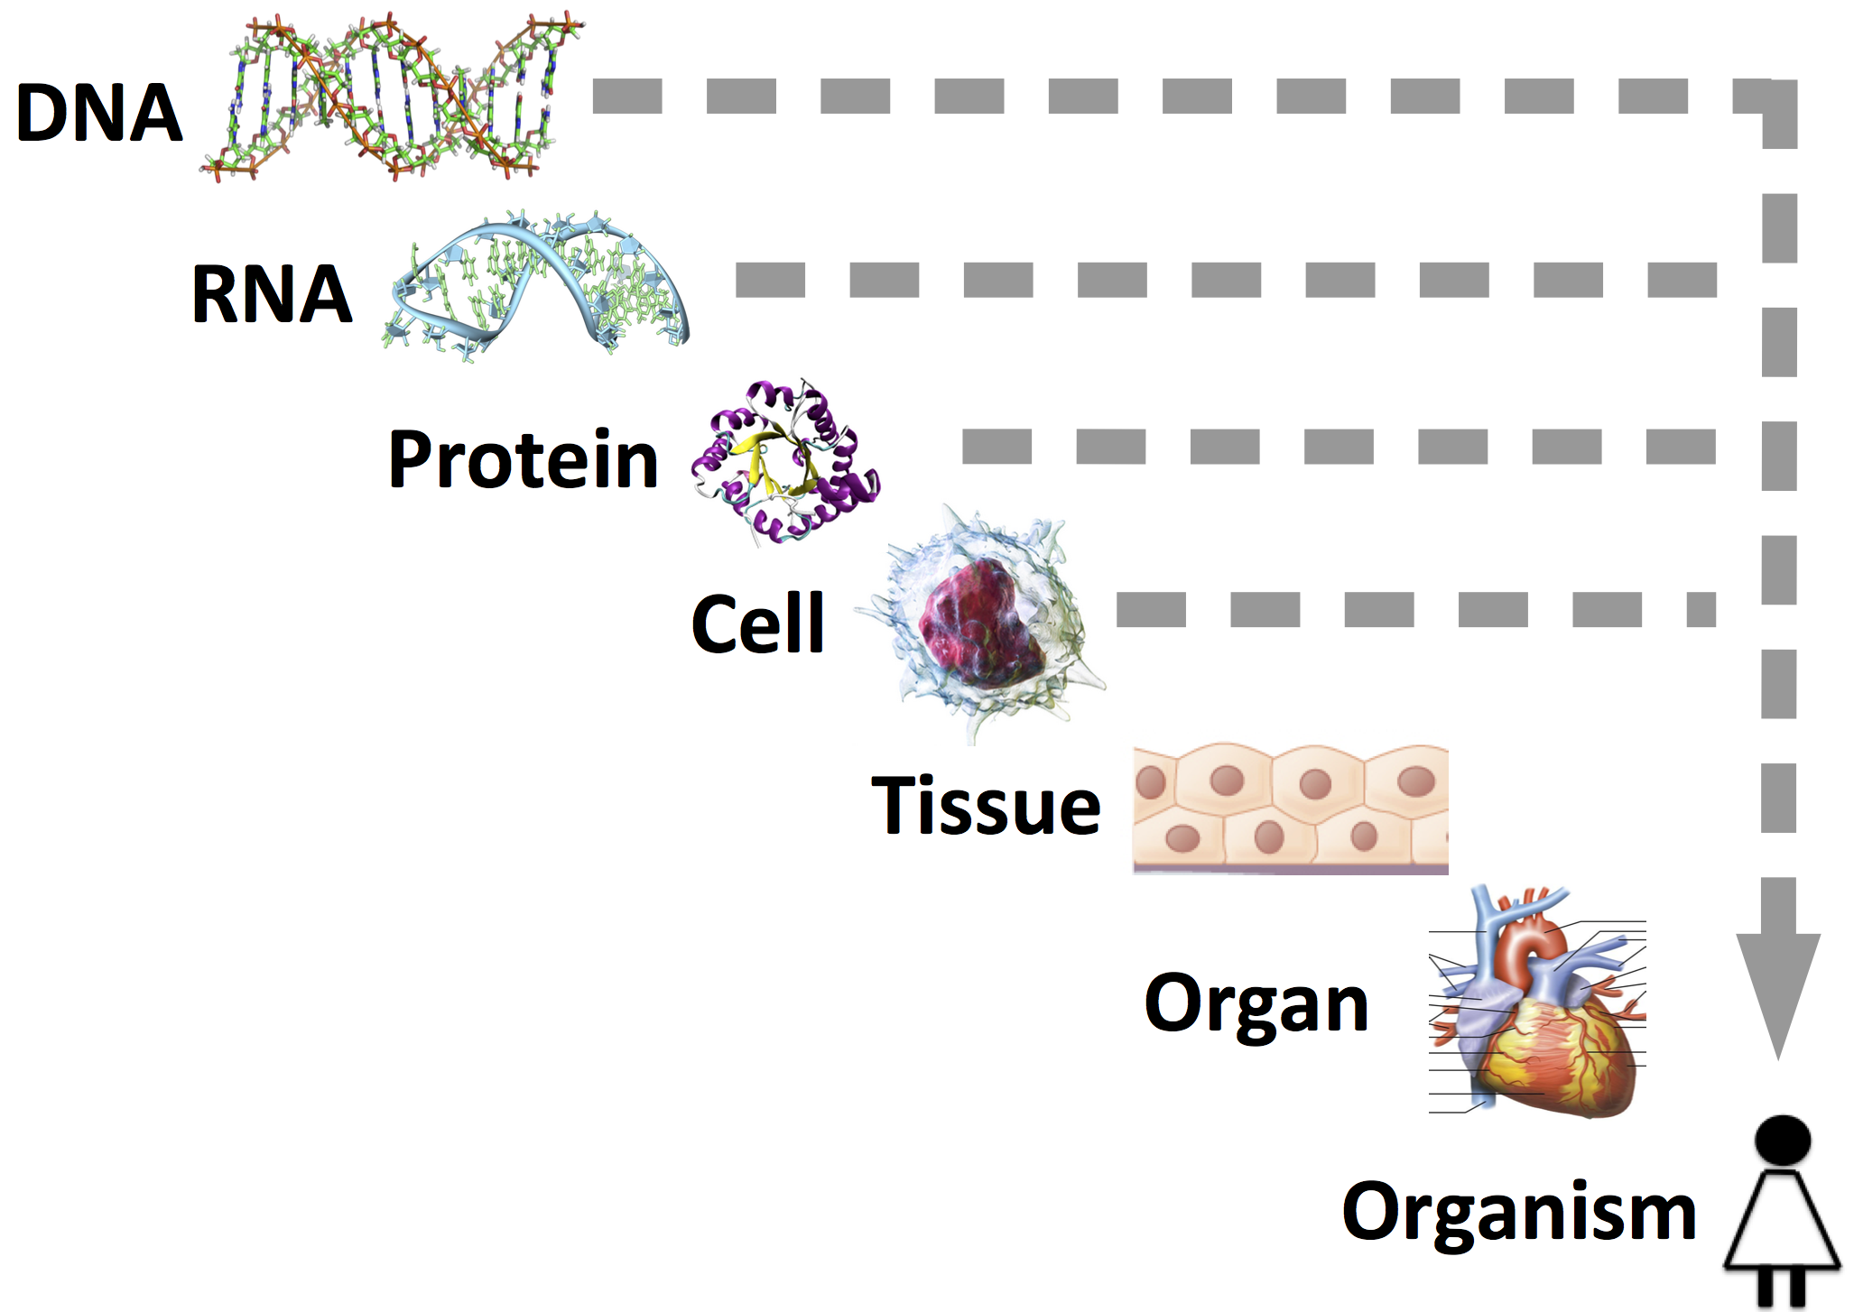

Slide 15
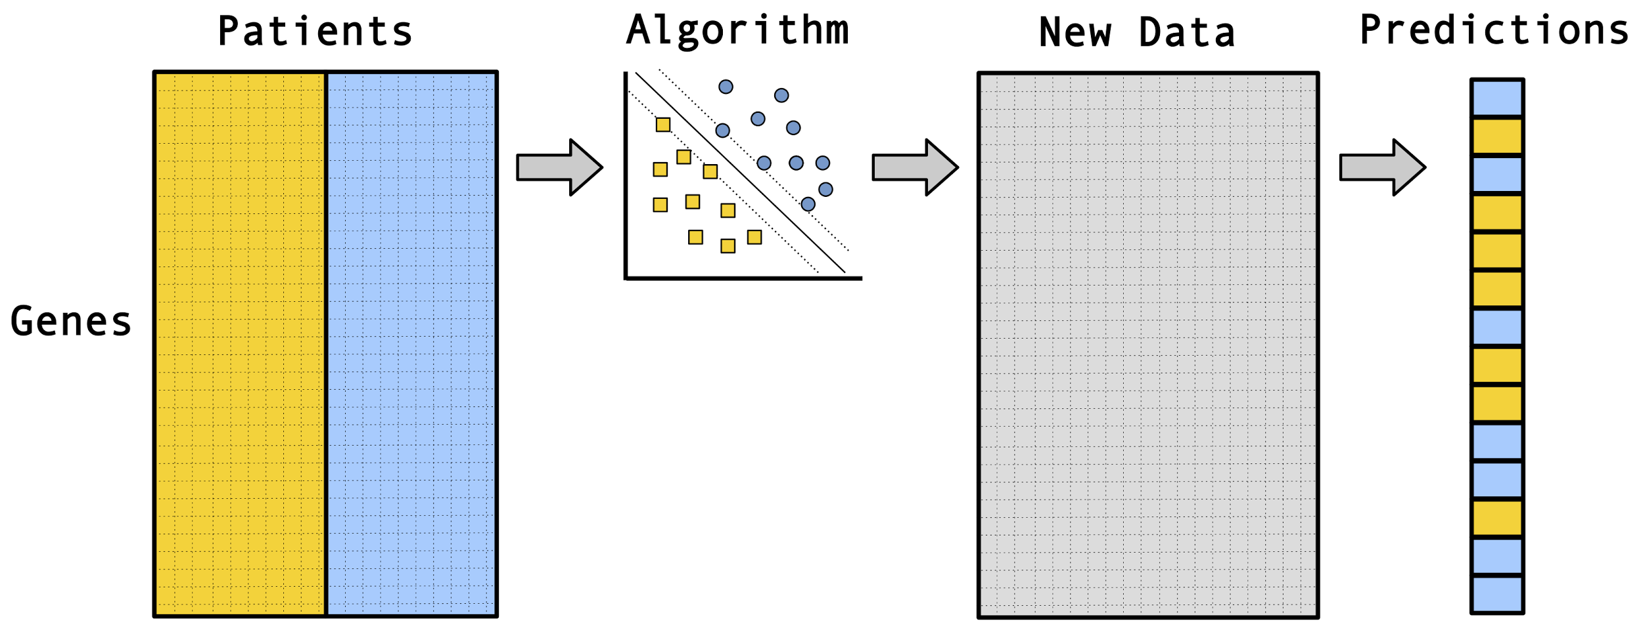
Classification approach

Slide 16
Hundreds of classification algorithms have been developed.

Slide 17
Most algorithms support multiple hyperparameters.

Slide 18

Which algorithm(s) and hyperparameters should I use on my data?

Slide 19
Option 1
Ask a friend

Slide 20
Option 2
Try a bunch of algorithms

Slide 21
Option 3
Develop your own algorithm

Slide 22
A better way
Select algorithms and hyperparameter values in a data-driven manner!

Slide 23
To do this effectively, we need a lot of high-quality data

Slide 24
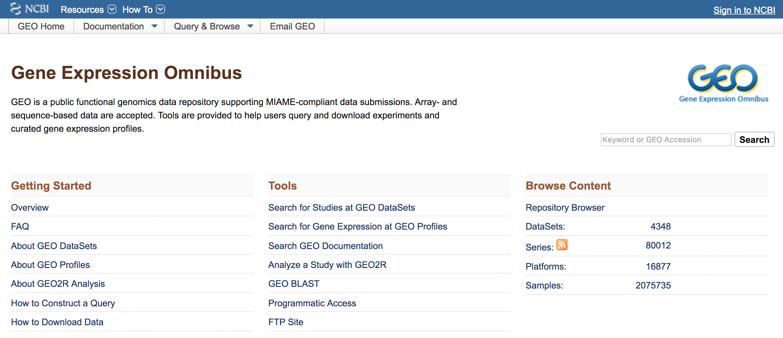

Slide 25
Barriers to reusing GEO data
Expression data
Inconsistent normalization
Low-quality samples
Duplicate samples
Clinical data
Inconsistent naming conventions & structure
Missing values (also represented inconsistently)

Slide 26
Biomarker Benchmark

Slide 27

Renormalization & BrainArray mapping

Slide 28
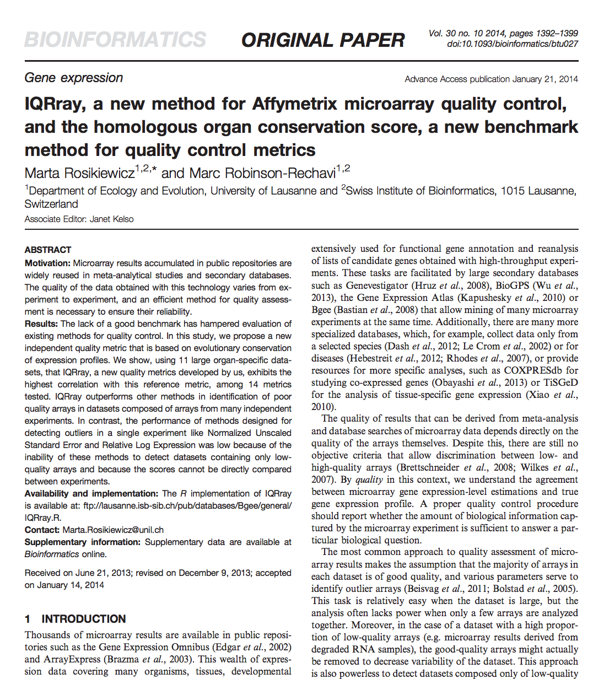
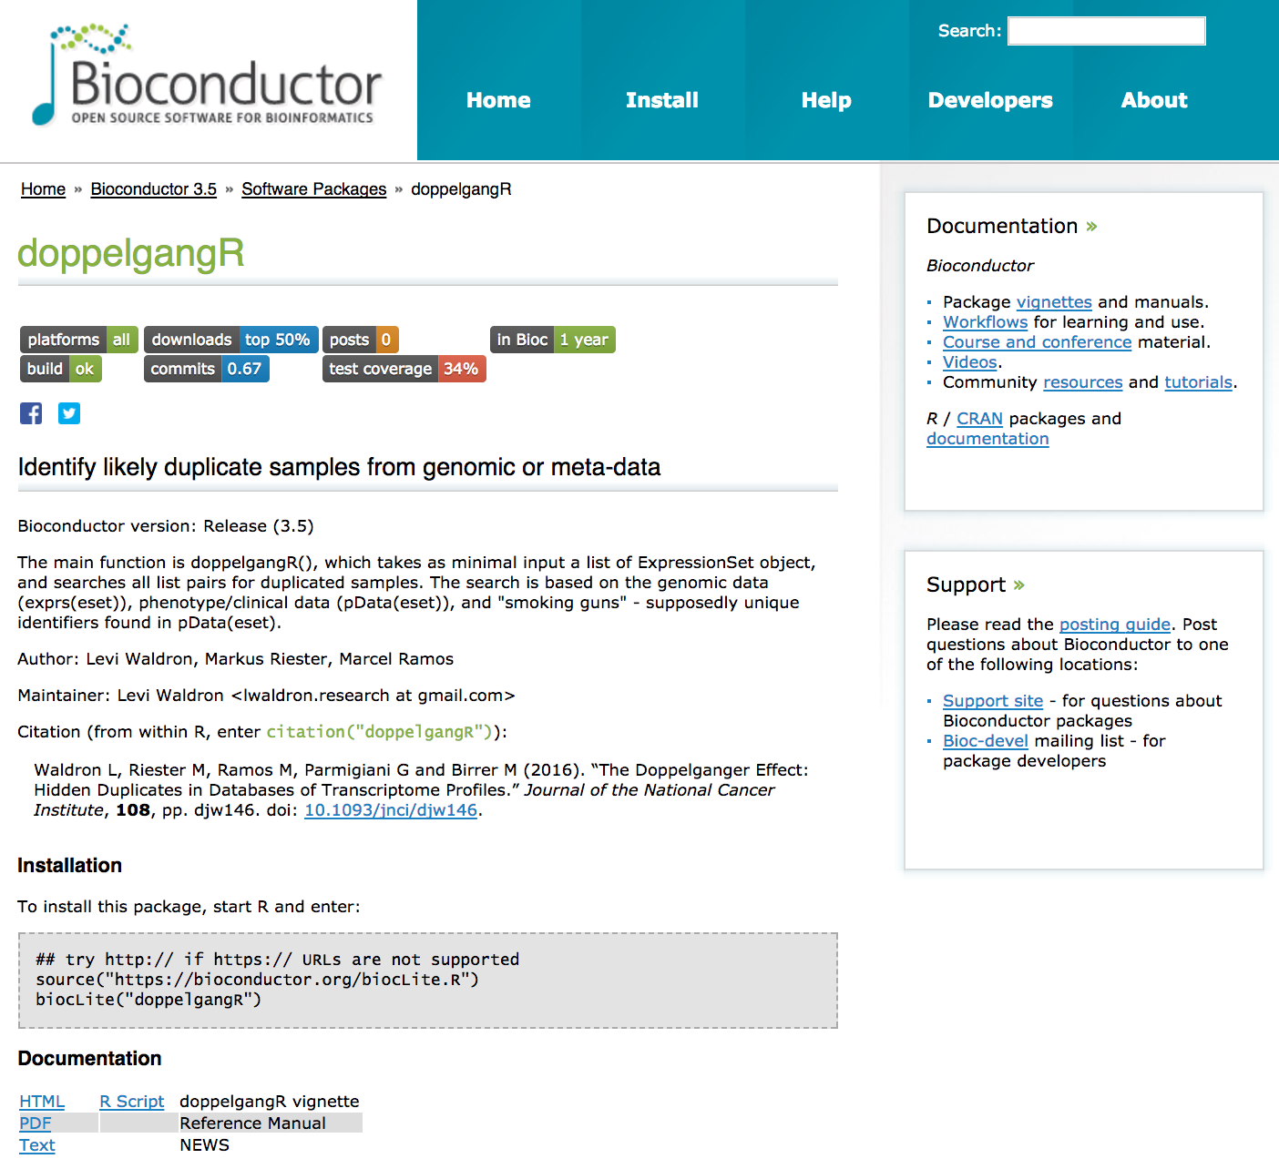
Quality control

Slide 29
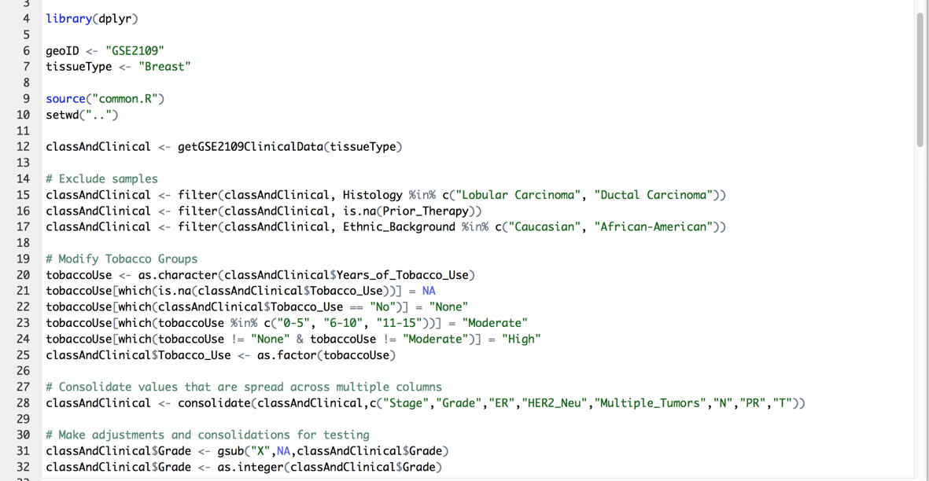

Slide 30
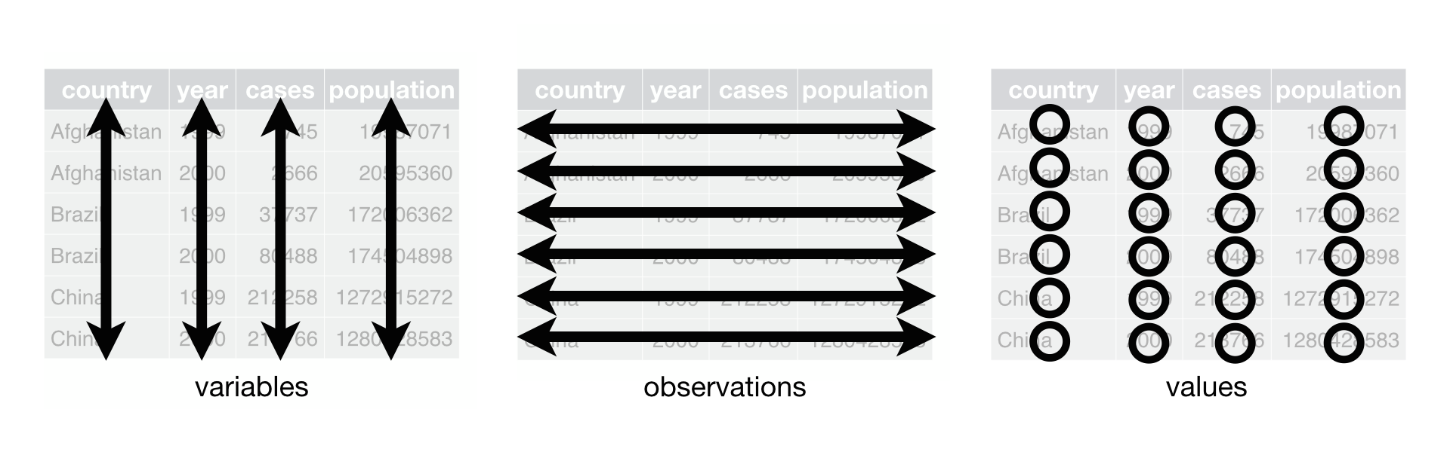
"Tidy data" outputs

Slide 31
Curated to date
45 data sets
100+ cancer states
7,037 samples
All Affymetrix data (for now)
Mostly related to cancer

Slide 32
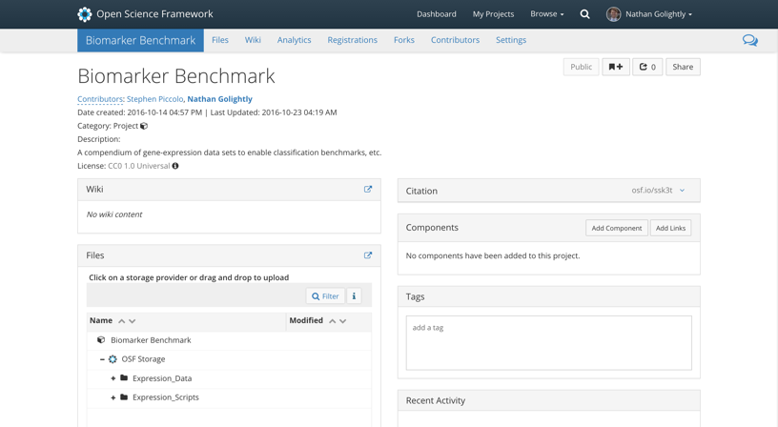
https://osf.io/ssk3t/

Slide 33
Benchmarking analysis

Slide 34

A machine-learning aggregator
50+ classification algorithms
15+ feature-selection algorithms
“Tidy data” output
Docker container
https://github.com/srp33/ShinyLearner

Slide 35
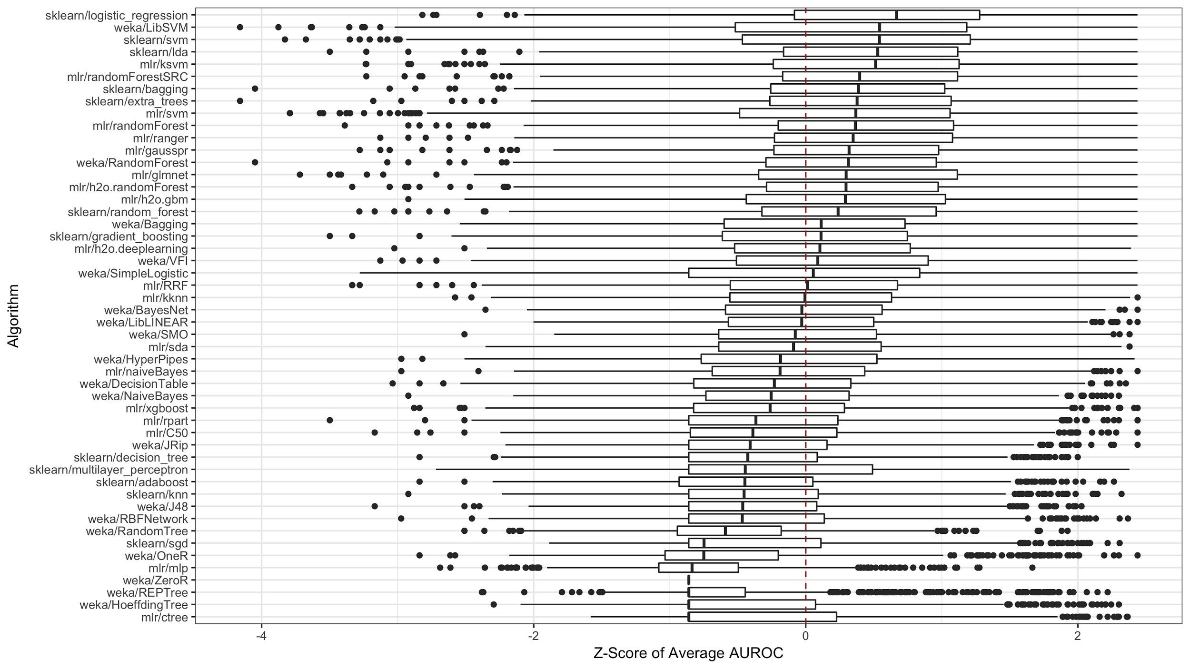

Slide 36
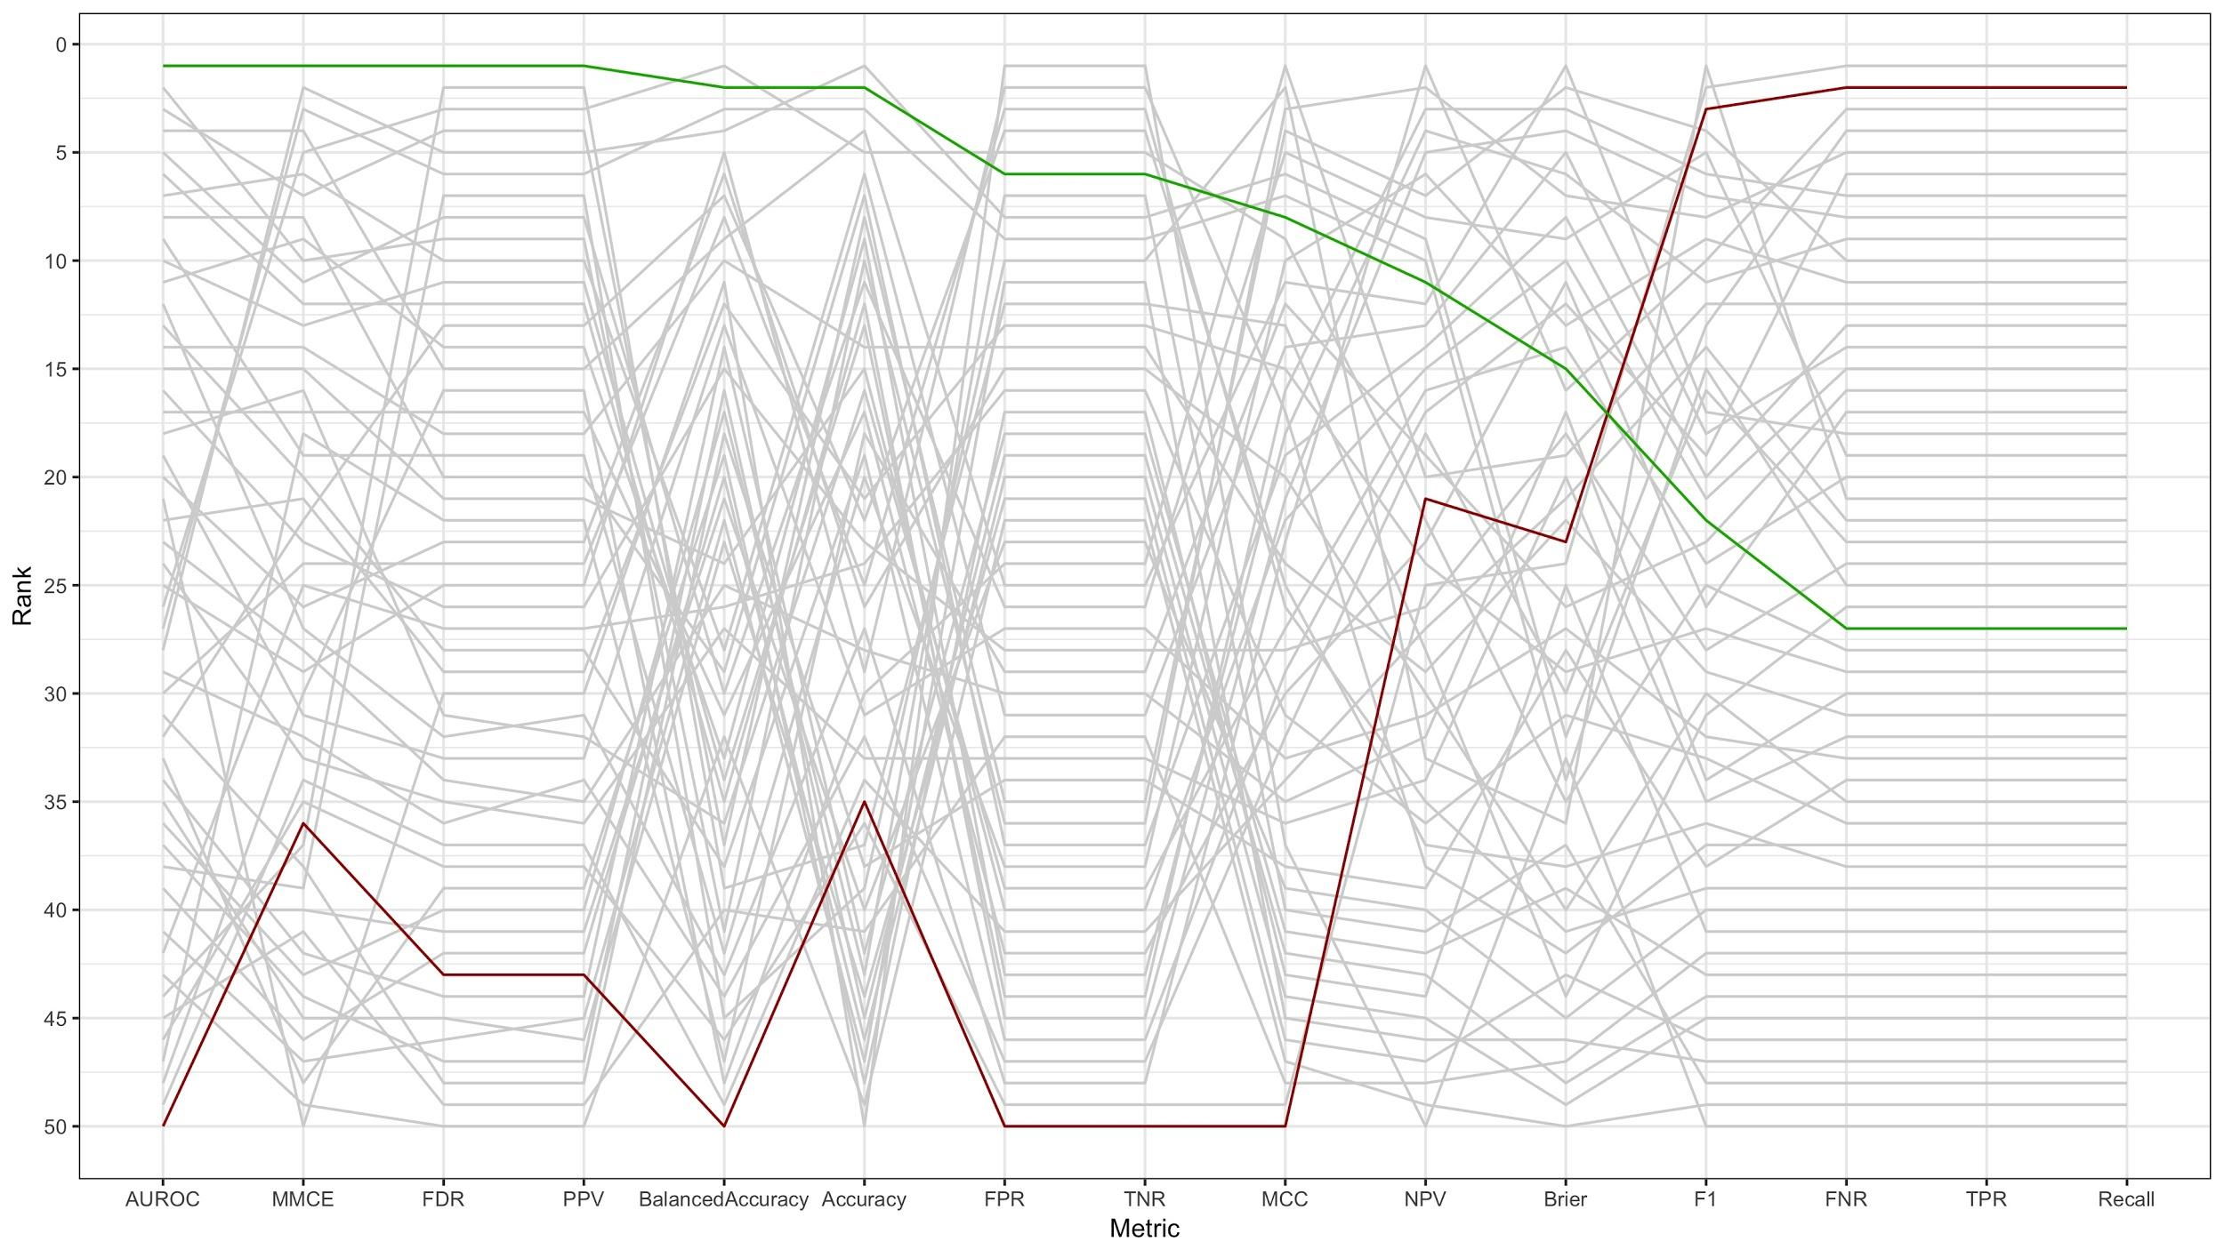

Slide 37
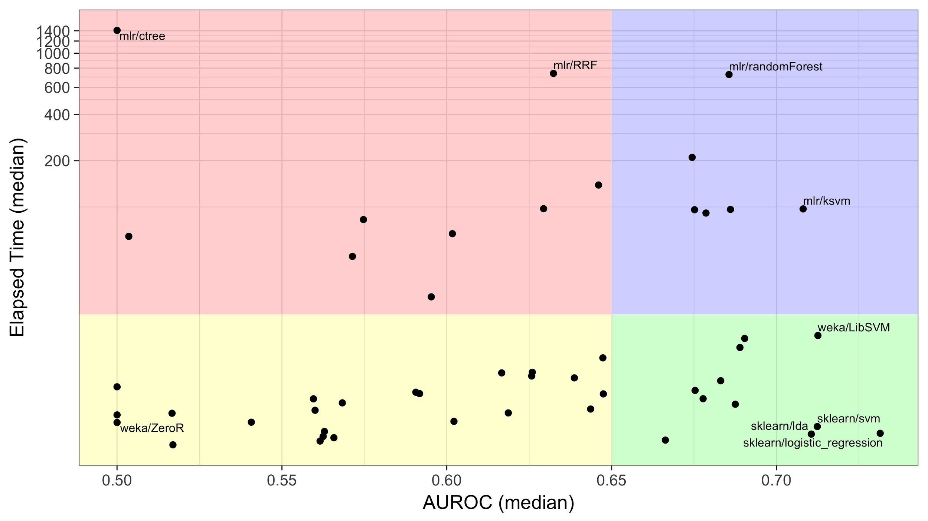

Slide 38




Acknowledgements
Nathan Golightly
Anna Bischoff
Avery Bell
Patients who consented to share data!

Slide 39
Questions?
http://bit.ly/piccolo_bioc2017

