Slide 1

TCGAbiolinks, Elmer & FunciVAR:
Tools for analysis and interpretation of the cancer genome
Bioinformatics and Functional Genomics
Benjamin Berman
Dennis Hazelett

Slide 2

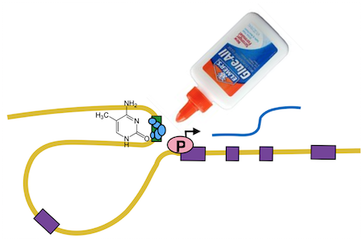


A complete framework for epigenomics analysis
TCGAbiolinks
GDC data
Germline
Somatic tissue
Disease samples
ELMER
FunciVAR

Slide 3
Workshop 1: Tiago Silva (July 28th 1:00-2:45)
“Integrative analysis with TCGAbiolinks and ELMER”
Search and download Methylation experiments → Summarized Exp object
TCGABiolinks GUI
Identify DNA methylation changes
Correlate methylation with gene expression
Upstream TF networks

Slide 4
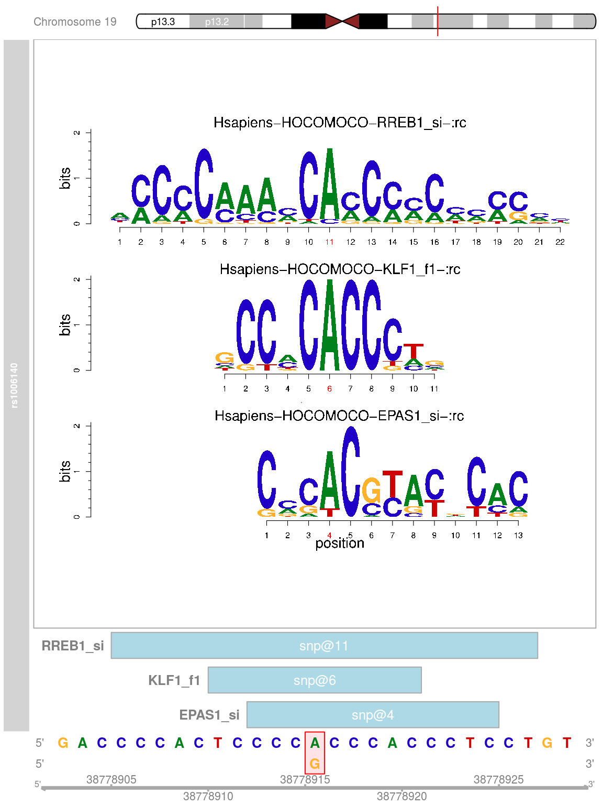
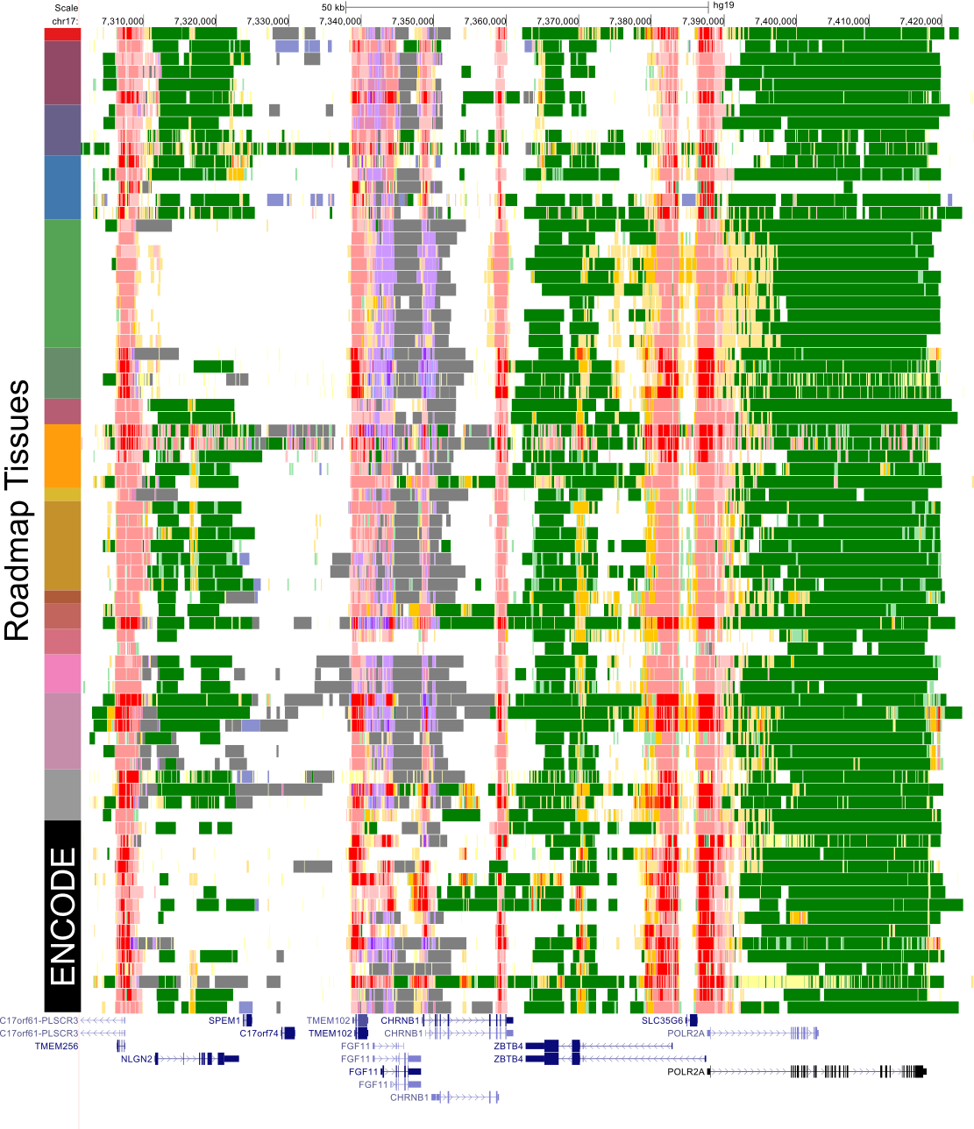
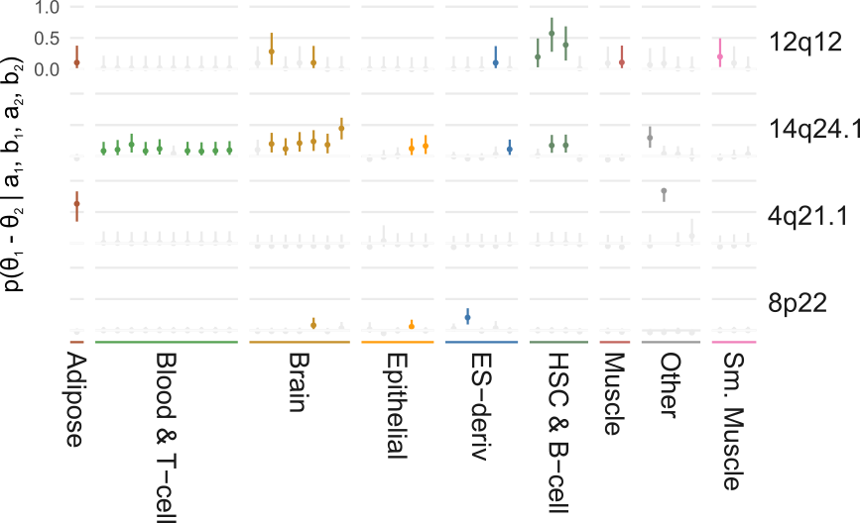
Workshop 2: Simon Coetzee (Date-Time)
“Variant Annotation with FunciVAR, StateHub and MotifBreakR”
Annotation and enrichment analysis with FunciVAR
TF disruption
Chromatin states

