Slide 1
MIRA: an R Package for Inferring Regulatory Information from DNA Methylation Data
Presented by: John Lawson
Developed by: John Lawson, Nathan Sheffield

Slide 2
DNA Methylation
DNA methylation
An epigenetic mark that affects gene regulation
Addition of a methyl (CH3) group to a cytosine
Methylation can interfere with transcription factor binding
Lower DNA methylation of enhancers and promoters is associated with more protein binding and activity
DNA methylation data contains regulatory information

Slide 3
Purpose of MIRA
Use genome-wide methylation data to infer regulatory information
Aggregates methylation data in regions of interest across the genome to make a “meta-profile” from which you can infer system-level activity of these regions
Overcomes sparse methylation data through aggregation of genome-wide data
Takes advantage of publicly available region sets

Slide 4
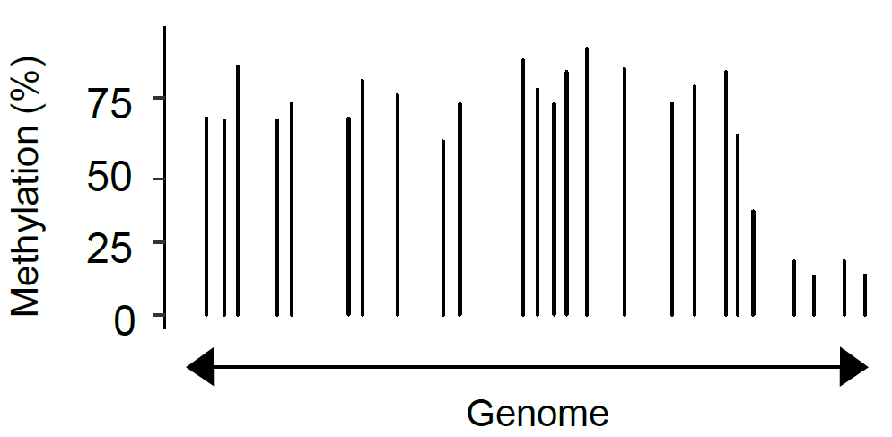
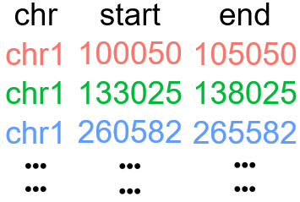
MIRA Workflow: Inputs
Input 1: Genome wide single nucleotide resolution DNA methylation data
Input 2: A set of genomic regions that share a biological annotation

Slide 5
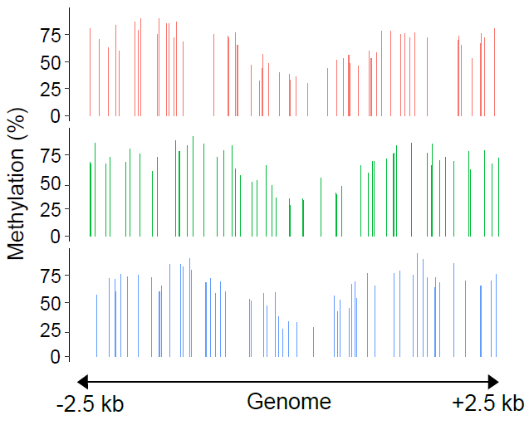
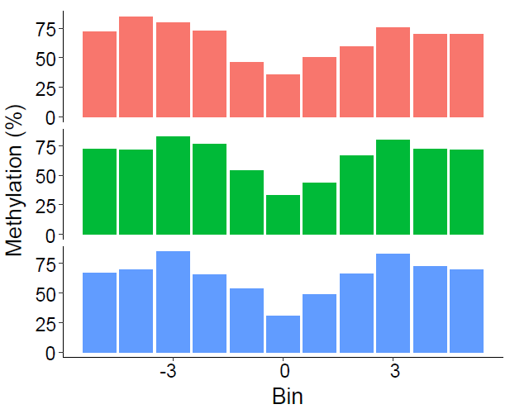
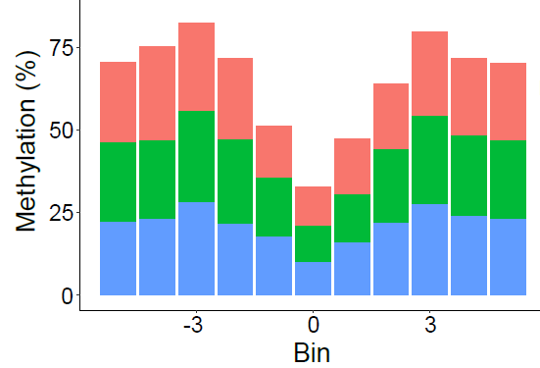
MIRA Workflow: Binning and Aggregation
Average methylation within each region by bin
Collapse regions into meta-profile

Slide 6
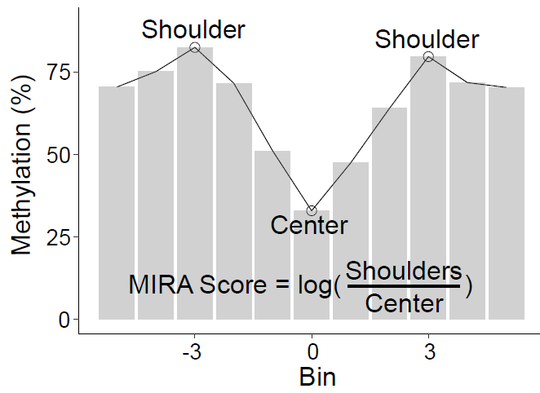
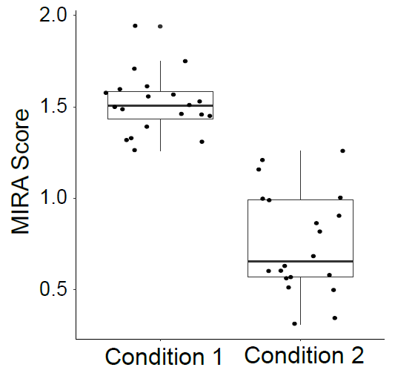
MIRA Workflow: Scoring and Comparing
Score profile based on the deepness of dip
Assumption that deeper “dip” equals more activity
Compare scores between samples, within and between groups

Slide 7
Conclusion
MIRA package provides a novel way to infer systems-level regulatory information from DNA methylation data
Notes:
Don’t talk about sparsity, talk about simple comparison.
Overcomes sparse methylation data by aggregating across the genome

Slide 8


Acknowledgments
Nathan Sheffield: advisor and creator of package
UVA Biomedical Engineering Graduate Program

